Slide 1
Git & GitHub
Introduction

Slide 2
Version Control System (VCS) is one of the most critical tools for coding and digital application development.

Slide 3
Git is the most commonly used version control system.
GitHub is one of the most popular Remote Repository services based on the Git platform.

Slide 4
What is Git?

Slide 5
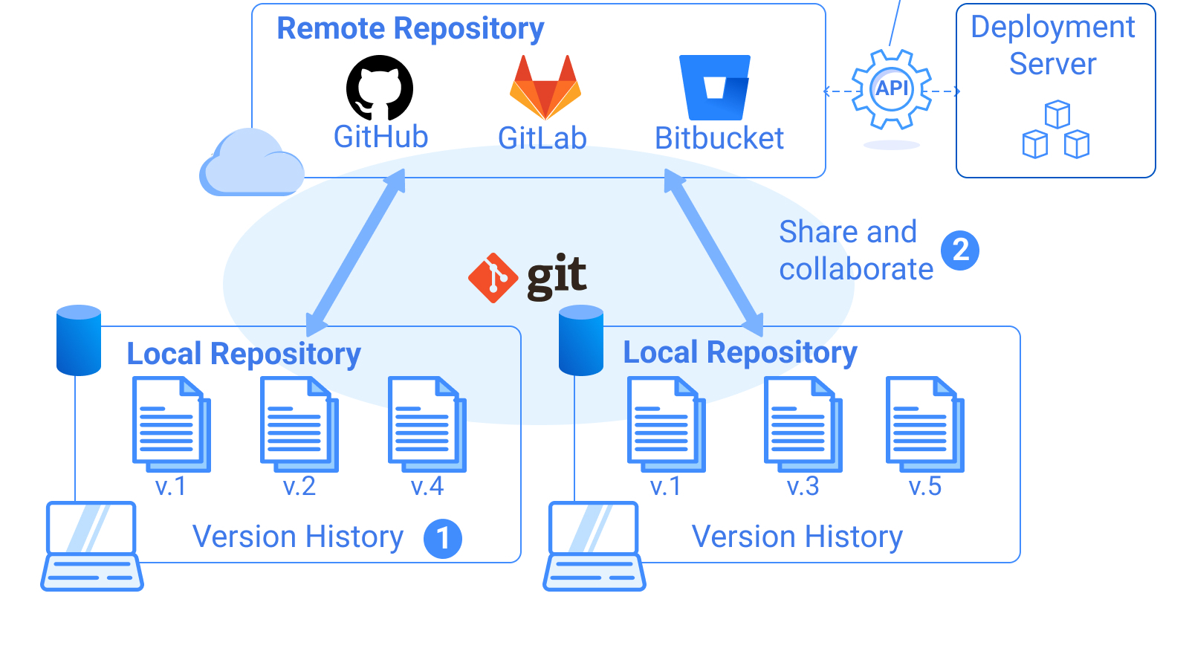

Slide 6
Git vs GitHub
Git and GitHub are different things
Git is a version control system
GitHub is a repository service provided by GitHub, Inc.

Slide 7
Git vs GitHub
Typically, remote repository services also offer task management features besides collaborative coding features.
Example: GitHub provides Git Issues that allow you to input tasks and share them with your team. GitHub or other remote repository services can also integrate with other services for workflow automation.

Slide 8
Git is a free and open-source distributed version control system.
Git is often used with remote repository services such as GitHub, GitLab, and Bitbucket.

Slide 9
Git and remote repository services like GitHub typically provide three key features
Version Control:
Using Git, you can record, track, and retrieve your coding histories.
Collaborative Coding:
On Git and remote repository services, you can share your code, get others' codes, and work as a team.
Task Management & Automation:
Most Git remote repository services provide additional features to manage tasks and automate workflow such as auto deployment.

Slide 10
What Is Version Control?

Slide 11
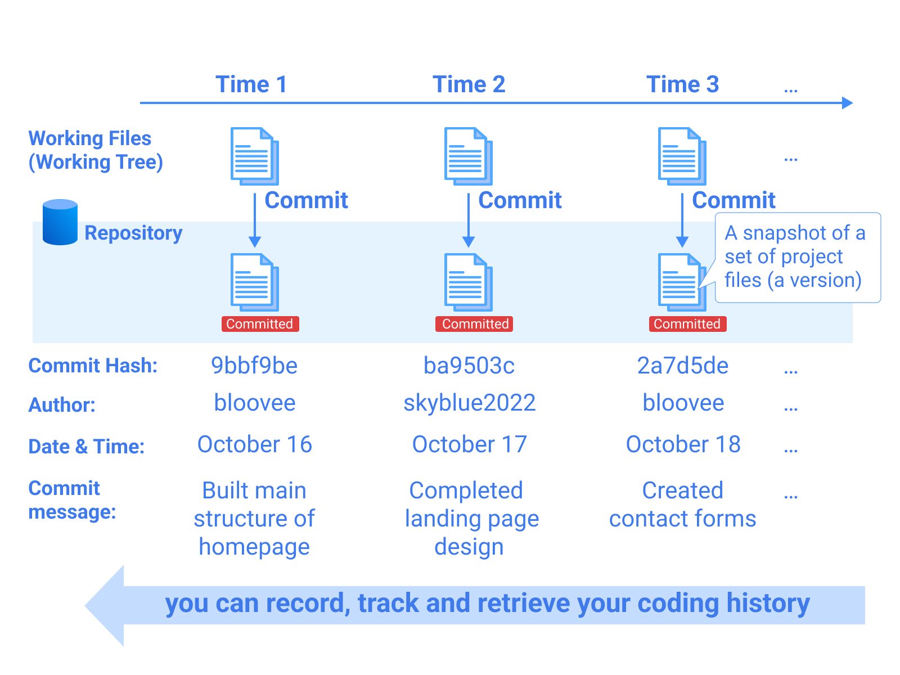

Slide 12
When coding, you need to manage several files which are dependent on one another.
If you want to save different versions, you need to save entire sets of files in different directories with version names.
This approach is very computer resource-consuming.

Slide 13
Git provides solutions for this with simple Git commands.

Slide 14
There are two keywords to understand the Git coding history management
Repository
Commit

Slide 15
Repository
A repository is a location where different versions of codes are stored.
There are two types of repositories:
Local Repository: it is installed on your local computer
Remote Repository: it is usually created under a web platform such as GitHub on the Internet.

Slide 16
Commit
Commit creates a snapshot to record the status of coding in a repository.
Only committed files are recorded in the Git log system.

Slide 17
Commit
Committed files are saved with the following key information:
Commit hash: Unique number to identify each commit
Author information: Name and email address of the person who made the commit
Date and time: Timing of each commit
Commit message: Short title and description about the commit

Slide 18
How To Save Versions in Git?

Slide 19
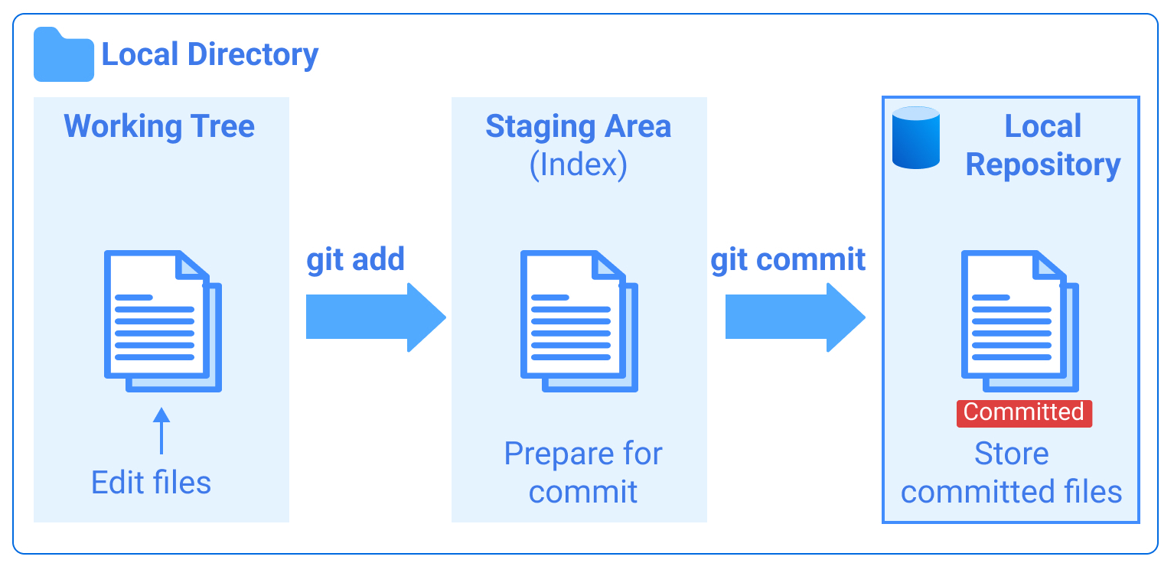

Slide 20

Git allows us to track all changes in our working files, however, it doesn't record every single change.

Slide 21
Git tracks only committed files (a snapshot of a set of project files).
This is like when we save a file on our computer as one version and save it again as another version with different file names.

Slide 22
Committed files are stored in a Local or Remote Repository.
Through the Remote Repository, you can share your work and collaborate with others.

Slide 23
Three-Stage Architecture

Slide 24
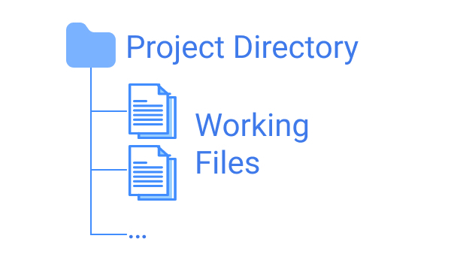

Slide 25
Stage 1: Working Tree (Working Directory)
Working Tree (Working Directory) is used to edit your working files.
The files and directories that you usually see in the project directory are the Working Tree.

Slide 26
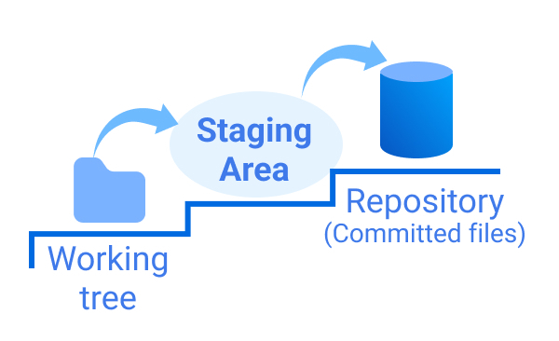

Slide 27
Stage 2: Staging Area (INDEX)
Staging Area (INDEX) is a buffer area used to prepare your working files for commit.
The command to bring the working files into the Staging Area is git add.
You can double-check if the files you added to the Staging Area are ready for commit.
If the files are ready, you can commit and save them under your Local Repository.
The command to commit files is git commit.

Slide 28
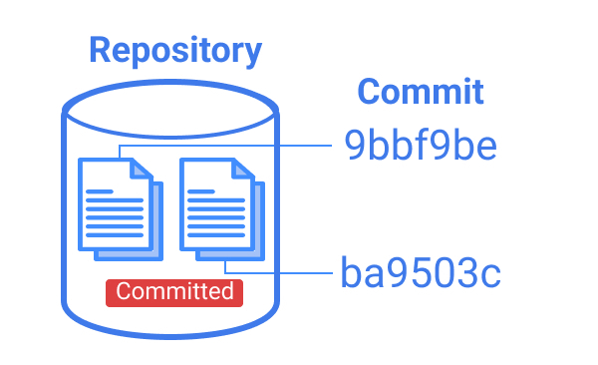

Slide 29
Stage 3: Local Repository
Local Repository is a place where committed files are stored with version histories.
By running the git commit command, you can commit your files in the Staging Area to save a version under your Local Repository.
At this stage, your files are still on your computer and not accessible to others.
To share the files, you need to bring the files to a Remote Repository.

Slide 30
When committing files, you need to write a message describing what the commit is about.
Example: "added payment function" or "fixed errors".

Slide 31
When running the git commit command, a text editor launches automatically for writing comments.
Vim text editor is the default setting typically.

Slide 32
Collaborating on Git & GitHub – Remote Repository

Slide 33
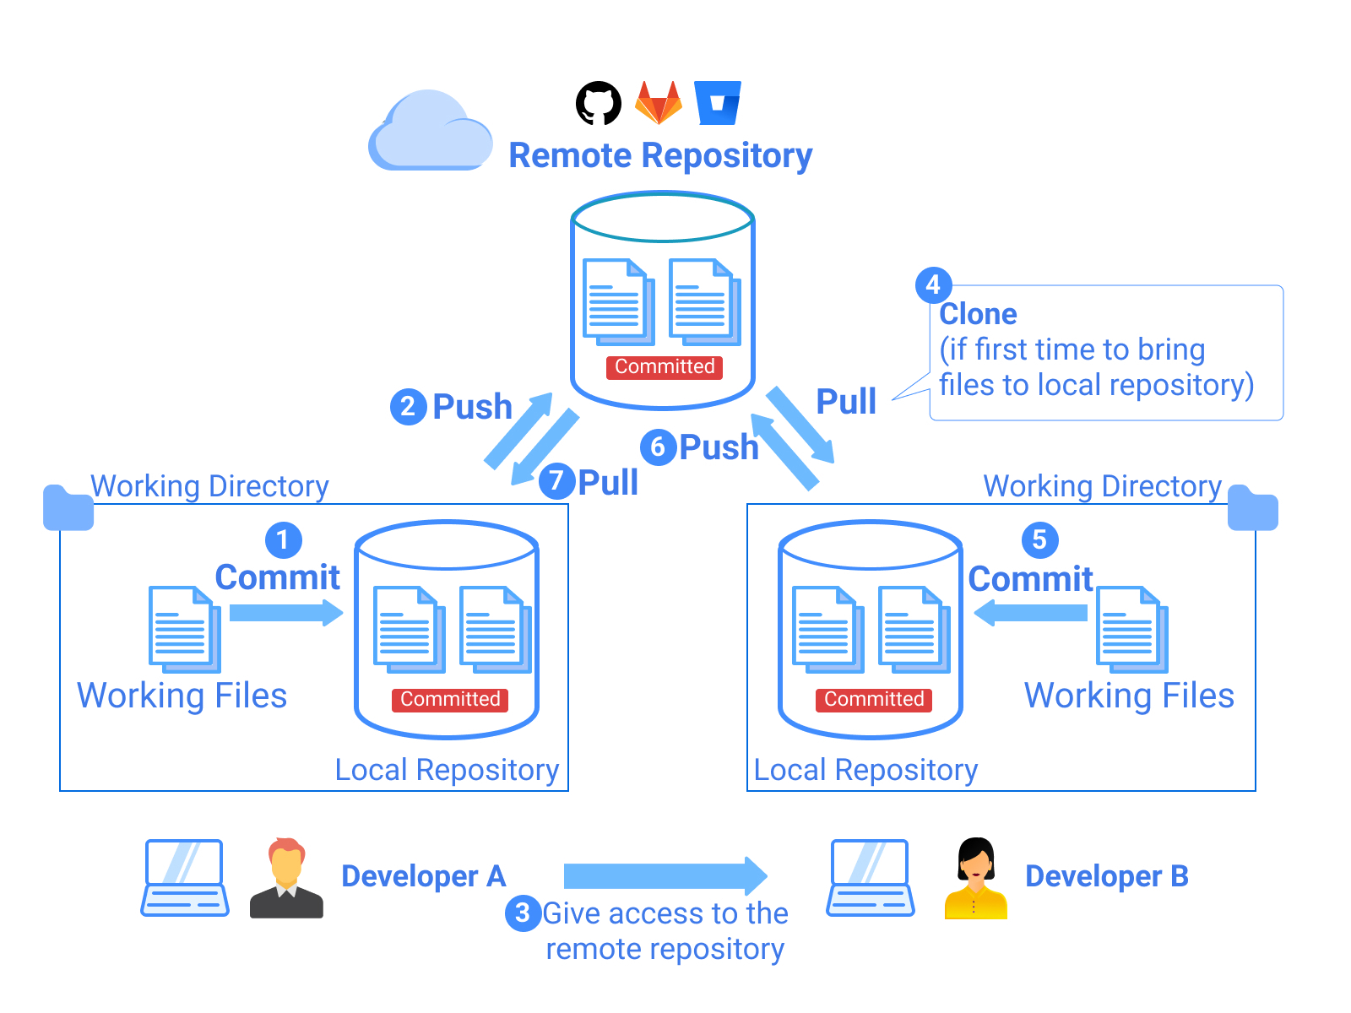

Slide 34
Collaborative coding is typically managed through a Remote Repository.

Slide 35
A Remote Repository is a place where committed files are stored on the web and can be shared with others.
GitHub, GitLab, or Bitbucket are the major remote repository services.

Slide 36
Interactions between a Local Repository and a Remote Repository are done through the command line on a local computer or a desktop application provided by remote repository services.

Slide 38
Developer A initiates a project, and Developer B supports Developer A
Developer A works on coding and makes the first Commit (saved in his Local Repository).
Developer A sends the committed files to his Remote Repository. This action is called Push. The command to push files is git push.
Developer A gives Developer B access to his Remote Repository.
Developer B brings the files from the Remote Repository to her local computer. When she does this for the first time, the action is called Clone.

Slide 39
Developer A initiates a project, and Developer B supports Developer A
Clone creates the same set of files as the Remote Repository in the local computer — committed files are registered in her Local Repository and the same files are saved under the project directory.
The command to clone is git clone.

Slide 40
Developer A initiates a project, and Developer B supports Developer A
Developer B can work on creating new lines of code and save them under her Local Repository (Commit).
Developer B pushes them back to Remote Repository where Developer A can access them.
Developer A can bring the files back to his Local Repository and his project directory. This action is called Pull.
The command to pull files is git pull.

Slide 41
Collaborating on Git & Git Hub – Branch

Slide 42
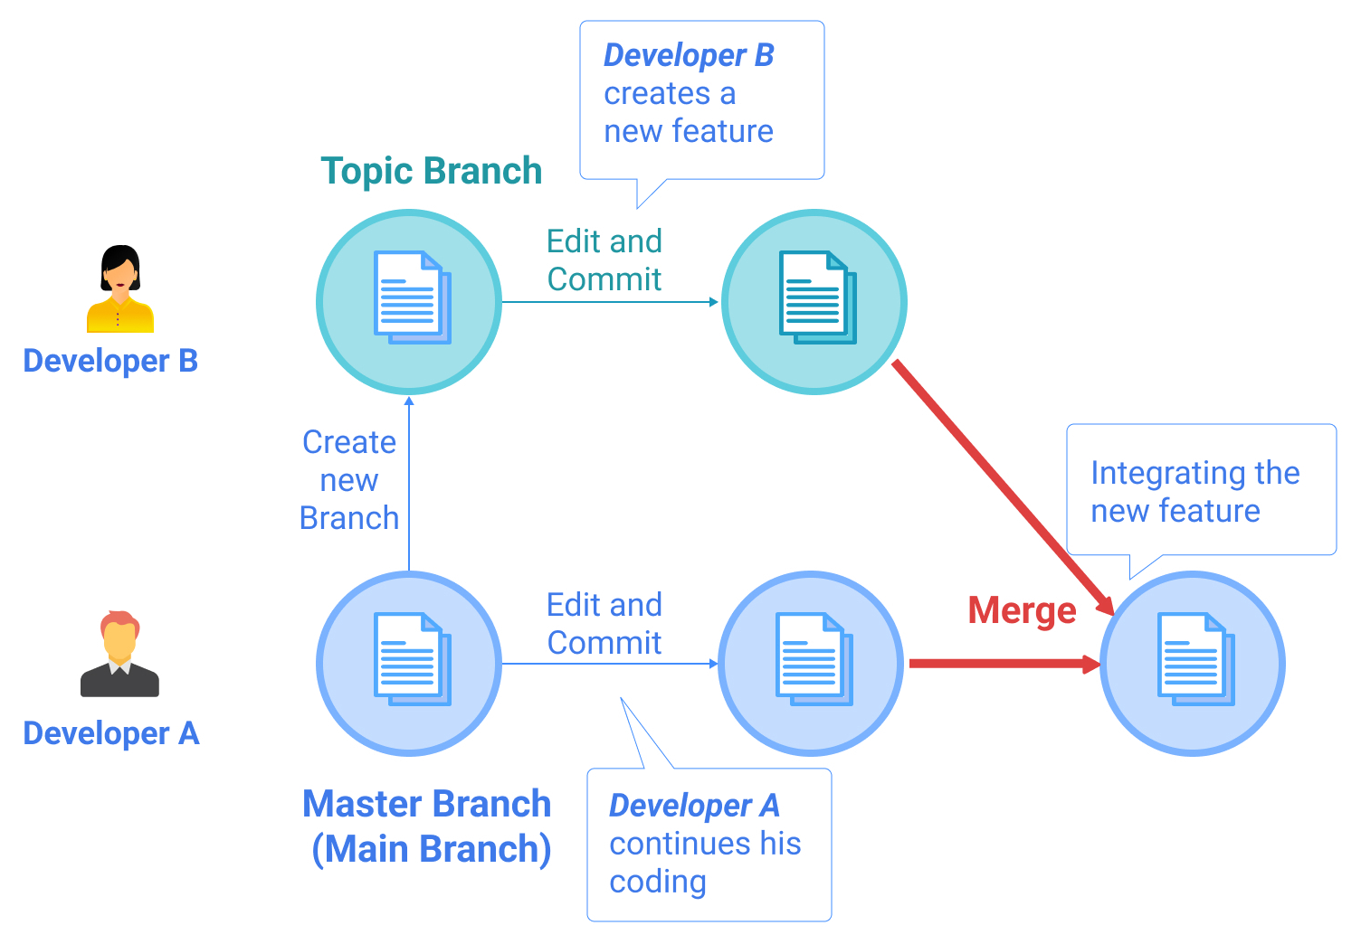

Slide 43
A Branch in Git is an independent line of development with a commit history.
Each branch provides a dedicated recording space and has its own coding history (a line of commits).

Slide 44
Branches allow us to manage different versions of the same set of project files simultaneously.
Example: one developer can work on adding a new promotion campaign feature while another developer is working on adding a new payment feature to the same web application.

Slide 45
Git provides a master branch as a default.
Unless you create a new branch, all your work is done on the master branch. The branch to create a new feature is typically called a topic branch.

Slide 46
Once development is completed in a topic branch, you can merge it with the master branch or its parent branch.

Slide 47
With the branching functionality, you can efficiently collaborate with others. Or even you can utilize branches by yourself to manage versions to develop different features simultaneously.

Slide 48
master branch vs. main branch
When you create a repository from GitHub, the default branch name is main branch.
The concepts of the master branch and the main branch are the same.
Previously, the primary branch was called master branch; however, main branch as the primary branch name is becoming more mainstream.

Slide 49
Git & GitHub Basic Life Cycle

Slide 50
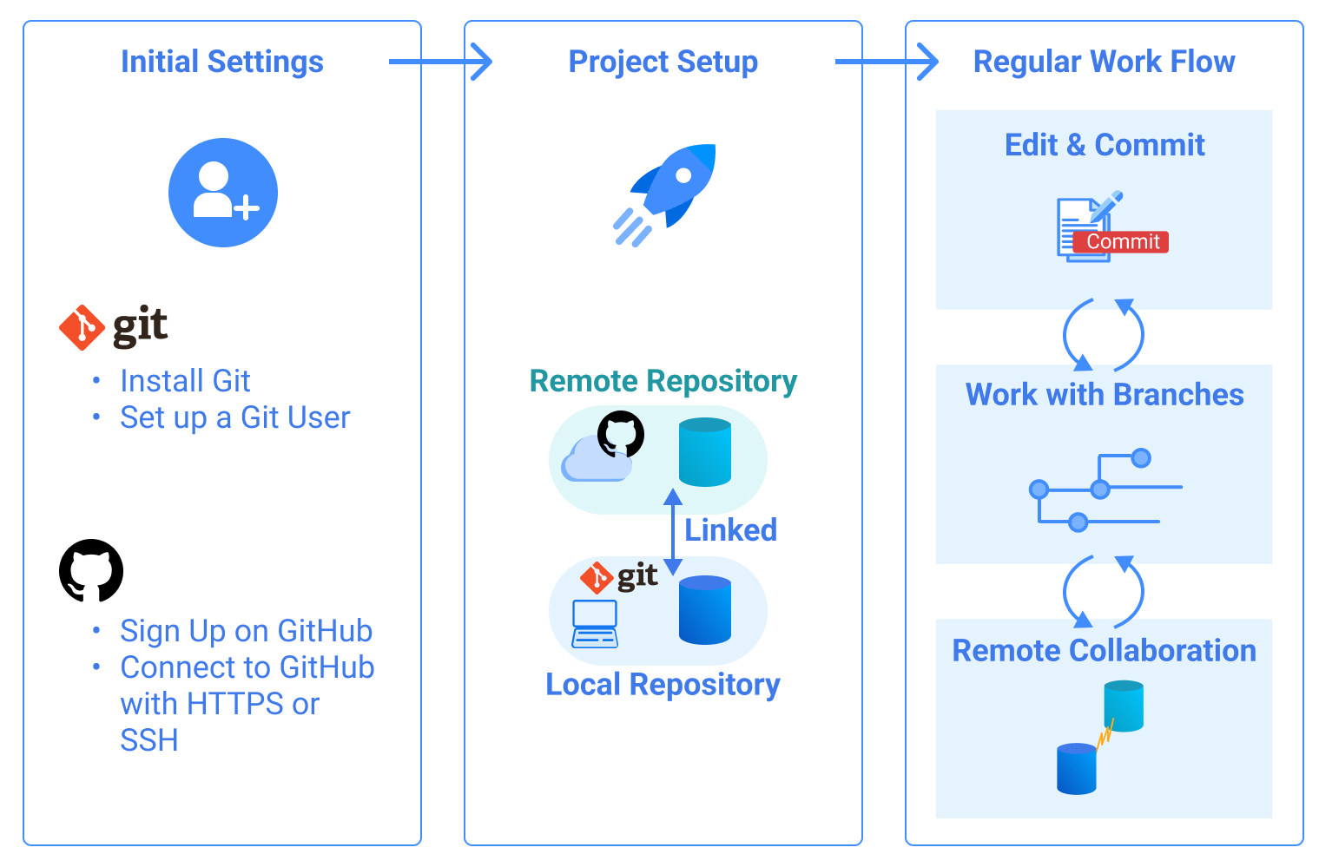

Slide 51
If you haven't used Git and GitHub before, you need to make the initial settings for Git and GitHub including sign up on GitHub and user profile settings.
You also need to set up a project with Git and GitHub. Once you complete a basic setup for your project, you can start to use Git and GitHub features.

Slide 52
There are frequently used features of Git and GitHub in the regular workflow.

Slide 53
1. Initial Settings

Slide 54
Before starting a project, you need to install Git software (if it's not preinstalled) and register your profile.
You also need to create a GitHub account and connect your local computer with the GitHub platform by making authentication settings (HTTPS or SSH).

Slide 55
2. Project Setup

Slide 56
To initiate a project with Git and GitHub, you need to create Local and Remote Repositories that will be used to save your coding and share your codes with others.
At this step, you'll also establish a connection between the Local Repository and the Remote Repository.
Depending on your project situation, the approach to project setup can be different.

Slide 57
Project setup approaches in three cases:
1. As a project initiator (owner)
2. As a project member (collaborator)
3. As a non-project member (creating a new project using a copy of an existing project)

Slide 58
Project Setup Target State
Regardless of the project setup approaches, there is a common target state of the project setup for Git and GitHub.
To fully utilize Git and GitHub functionalities, you need to meet the following three conditions:
A Local Repository for the project is created on your local computer
A Remote Repository for the project is created on GitHub, and/or access to the project's Remote Repository is granted to the necessary project members.
The Local Repository and remote repository are linked with each other so that both repositories can synchronize (typically through HTTPS or SSH connection)

Slide 59
Once Local and Remote Repositories are created for the project and linked, you should be able to see the same directories and files in both repositories.

Slide 60
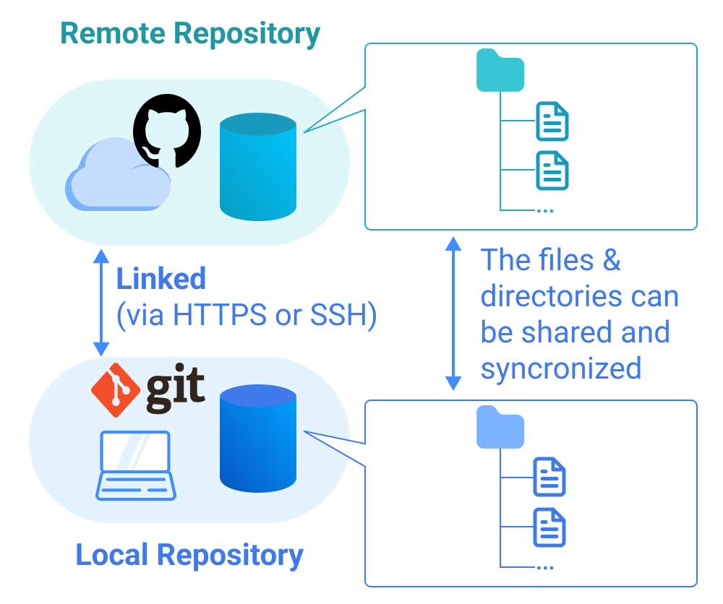
The target state of the Git and GitHub project setup. Once you establish this target status, you are ready to use Git and GitHub in an integrated way.

Slide 61
3. Regular Workflow

Slide 62
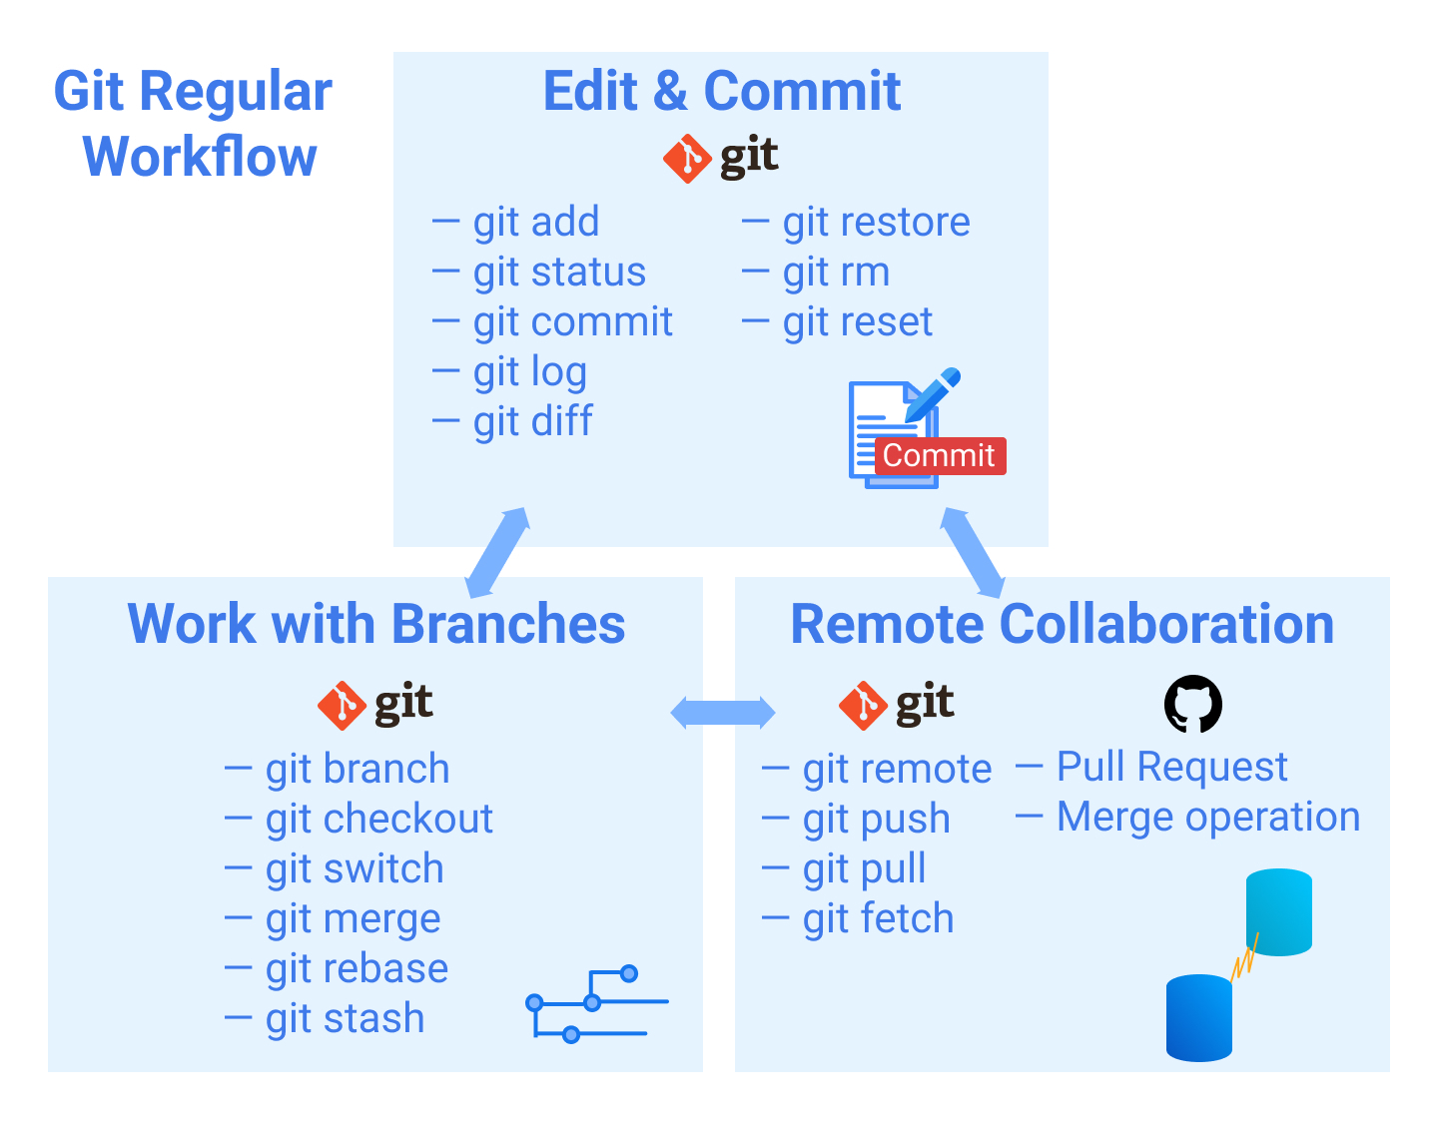
In the daily coding work with Git and GitHub, you are expected to use various Git commands and GitHub features on a daily basis along with the three operation areas.

Slide 63
Edit & Commit
Once you launch a project, you can start to write and edit your code.
You can save several versions of the code in your Local Repository by committing the codes.

Slide 64
Work with Branches
When you add some features while continuing to work on the main code development, you may want to manage several versions of the code.
The branch functionality allows you or your team members to work on different versions of code simultaneously.

Slide 65
Remote Collaboration
One of the key features of Git is that it allows collaboration with others.
You can share your code through a Remote Repository with your team members and vice versa.

Slide 66
Git & GitHub Initial Settings

Slide 67
Git & GitHub Initial Settings Overview

Slide 68
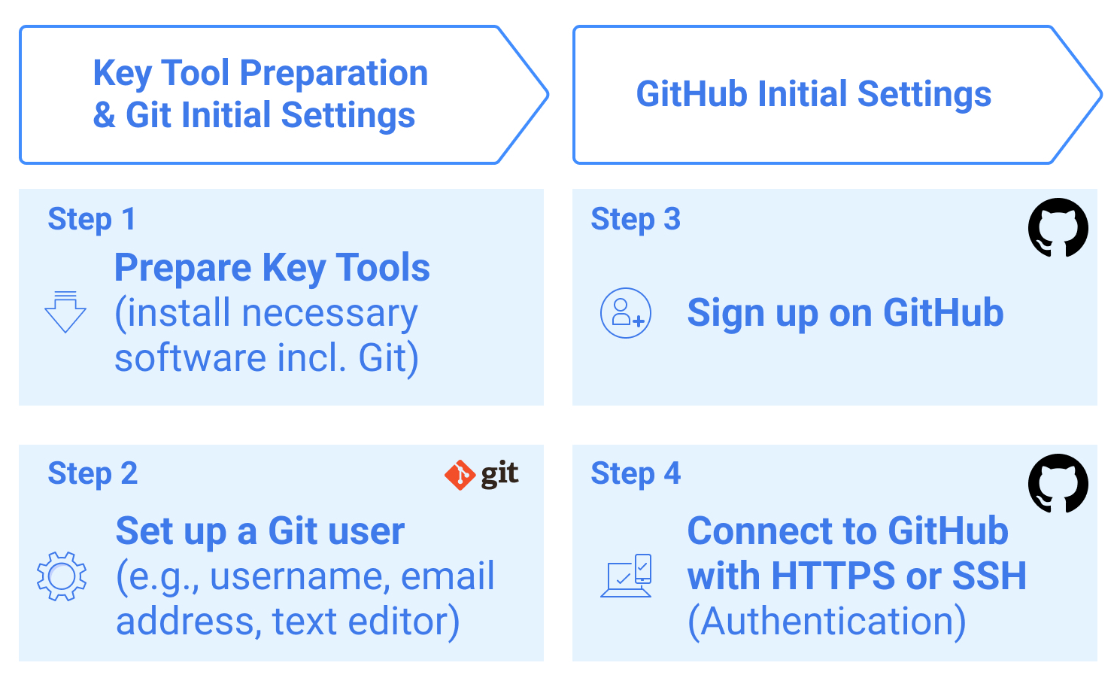
There are four key steps in the Git and GitHub initial settings.

Slide 69
Step 1. Prepare Key Tools (including Git software)

Slide 70
General programming tools
As Git and GitHub are coding support tools, you need to have the basic coding tools to use Git and GitHub in the coding project.
Command line to execute commands and run programs
Text editor to write code
Web browser to access GitHub platform and to use as a UI for the program if you are developing a browser-based app

Slide 71
Git software
To manage your coding project with Git, you need the Git software. You need to download and install it.
Key tool preparation approaches differ by OS (Mac, Windows, and Linux).

Slide 72
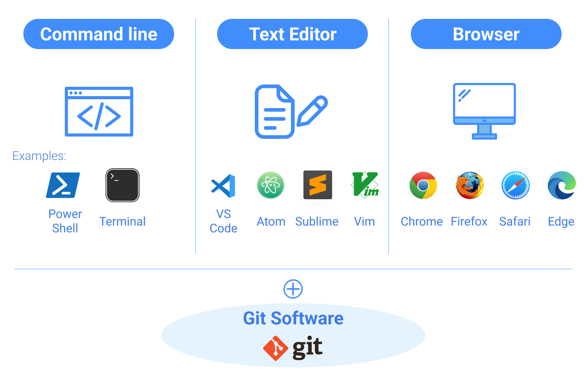

Slide 73
GitHub Desktop
If you are unfamiliar with the command line or CUI (Character-based User Interface), you can use Git with the GUI (Graphic-based User Interface).
GitHub Desktop is software provided by GitHub to enable you to use Git and GitHub features without a command line.

Slide 74
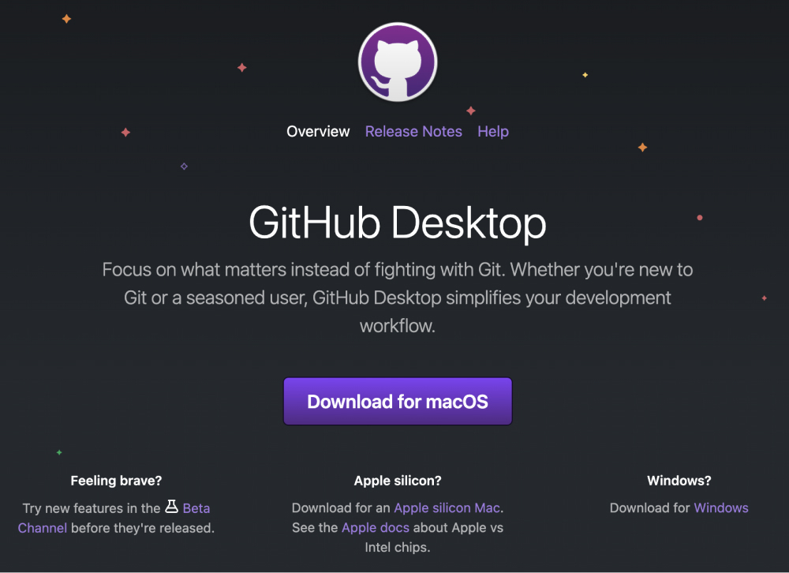

Slide 75
Step 2. Set up a Git user

Slide 76
As Git is a tool for recording coding histories including the author of edits, you need to input your basic information (i.e., username and email address).
You can also register your preferred text editor which is used when you make commit messages.

Slide 77
Step 3. Sign up on GitHub

Slide 78
To use GitHub, you need to sign up for the GitHub service on its website.
GitHub provides a free plan. You can start with the free plan for learning purposes.

Slide 79
Step 4. Connect to GitHub with HTTPS or SSH

Slide 80
To access GitHub from the command line, you must have proper authentication settings.
Common authentication approaches for GitHub are HTTPS and SSH. PAT (Personal Access Token) is used for HTTPS authentication while an SSH key pair is used for SSH authentication.

Slide 81
Key Tool Preparation - Windows

Slide 82
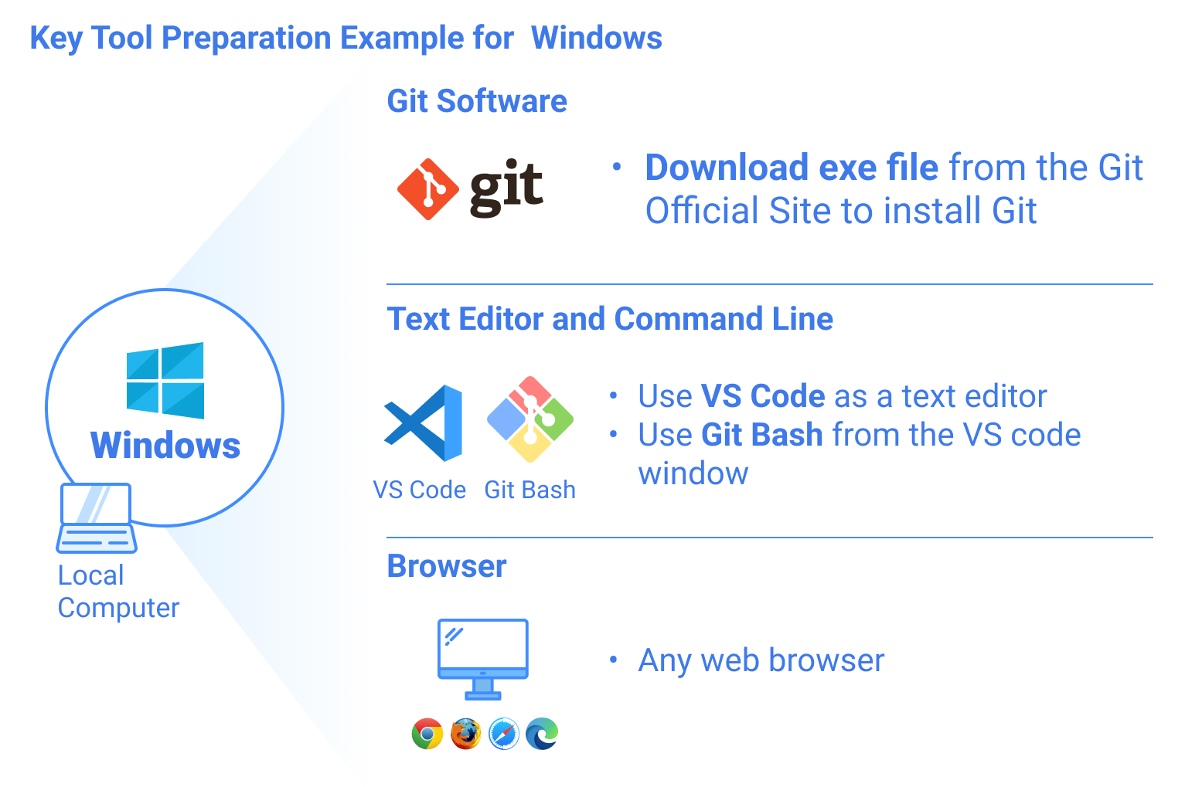
Preparing the Git environment in Windows is slightly complex.
You need to install the Git software with several initial settings.

Slide 83
For Windows, Powershell is usually used as a command line, but Git provides a Unix-based command line called Git Bash.
For the text editor use VS code.
You can open Git Bash using VS code so that you can use a command line and text editor in the same application.

